Slide 1
Building the Manufacturing Talent Pipeline
C³BC

Slide 2
The Manufacturers’ 501(c)3
Notes:
The Manufacturing Institute
The Manufacturing Institute is the authority on the attraction, qualification, and development of world-class manufacturing talent.
We wake up every day and worry about our skills gap.
We are the non-profit affiliate of the National Association of Manufacturers.

Slide 3
C3BC Update
Completed Trips
Los Angeles Valley College
Forsyth Technical Community College
Salt Lake Community College
St. Petersburg College

Slide 4
What we’ve found…
Only investing time. Return on investment is priceless.
Reduced turnover
Customize training based on company’s needs
Using programs for incumbent worker training
Gaining skills certifications
Salary increase for completers
Investing in employees’ futures
Training is saving companies’ money
Using as talent supplier – better quality candidates
Close-knit relationships
Notes:
From these 4 trips there have been a lot of positive recurring themes.
we’ve found that many companies are only investing their time into these programs and believe the return on investment is priceless.
Companies are experiencing reduced turnover.
Companies are able to slightly customize training based on their own needs.
They are using these programs for incumbent worker training
Employees and students are gaining skills certifications
Some manufacturers are offering salary increase for completers of the programs
Companies are investing in their employees’ futures by sending their people to these trainings
They are using these programs as talent suppliers and receiving better quality candidates.
The schools have very close-knit relationships w/ these companies and manufacturers.

Slide 5
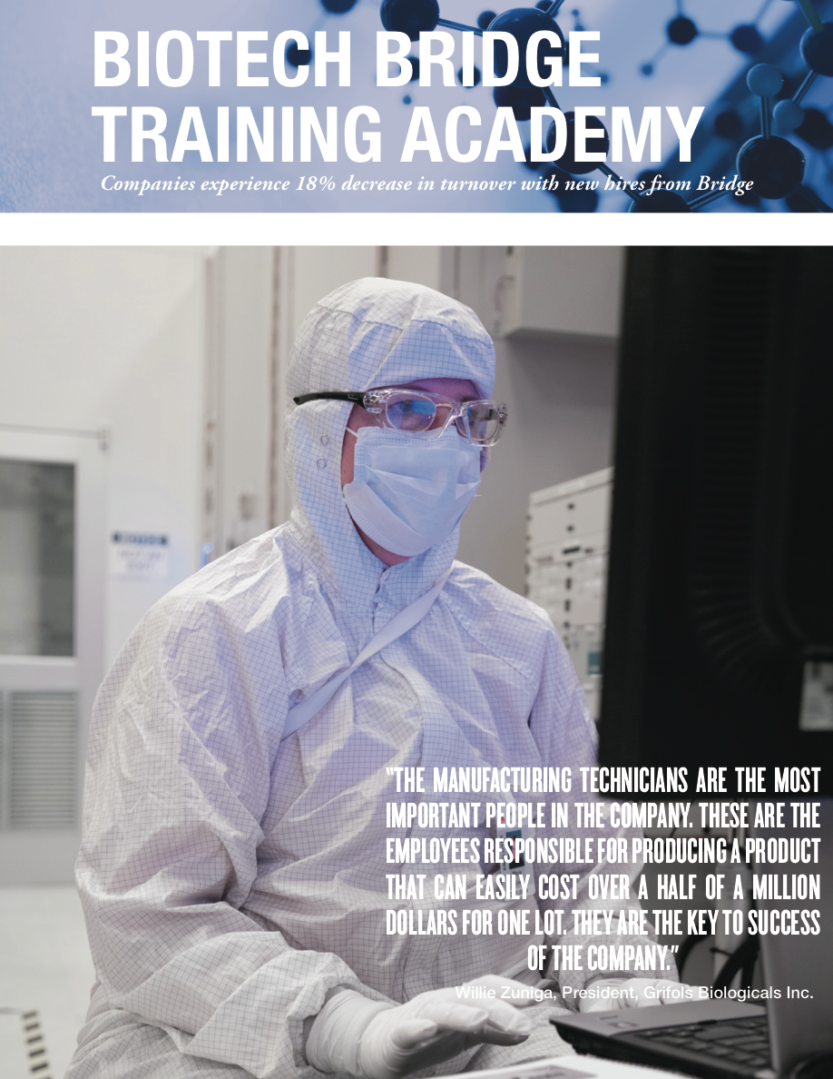
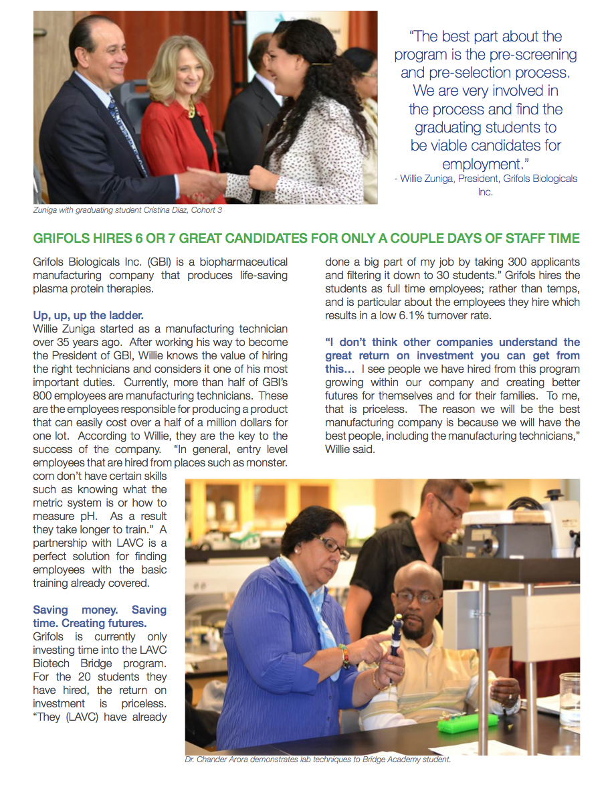

Slide 6
HIGHLIGHTS: LAVC
Baxalta hires 80% - 85% of students coming out of LAVC Bridge Academy
Grifols hires 6 or 7 great candidates for only a couple days of staff time
Grifols hires the students as full time employees; rather than temps, and is particular about the employees they hire which results in a low 6.1% turnover rate.
“LAVC provides such a great resource of diverse talent. They have connections, they can do the sourcing, and it really doesn’t cost us anything. I don’t have to hire another recruiter. It’s a win- win partnership for us,” said Liz Schulz, Director, Human Resources, Baxalta.

Slide 7
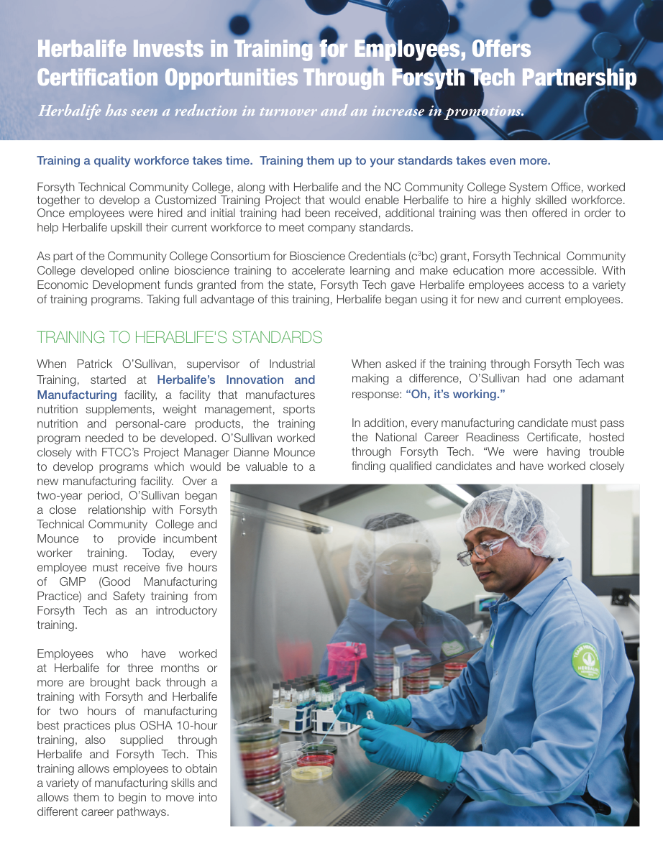
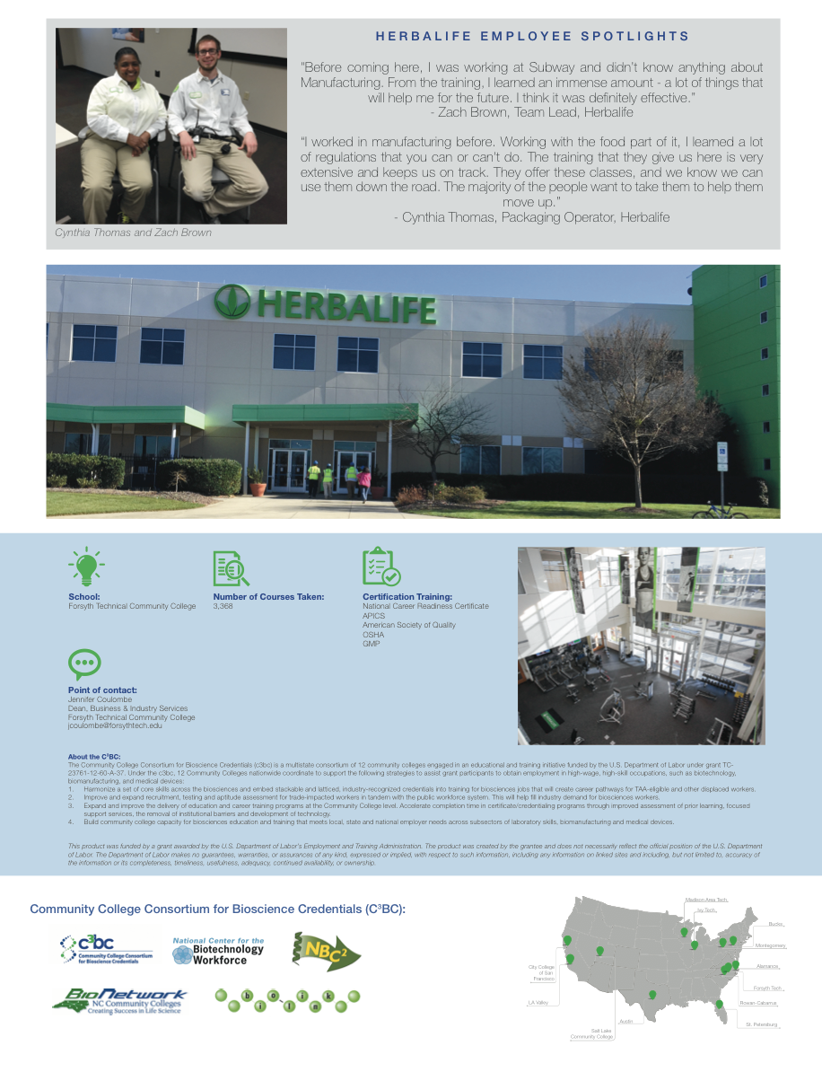

Slide 8
HIGHLIGHTS: FORSYTH TECH
2 year relationship with Herbalife
Every employee must receive 5 hours of GMP and Safety training from Forsyth Tech as an introductory training.
After successful completion of an initial work period, operators may be eligible to go through level 1 of the "toolbox training" and may receive a salary increase if they successfully complete the program.
Employees have gone through the program and have seen promotions.

Slide 9
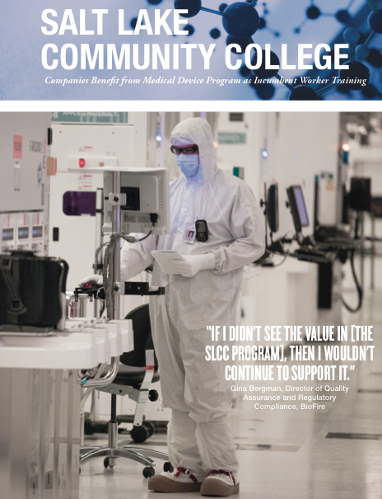
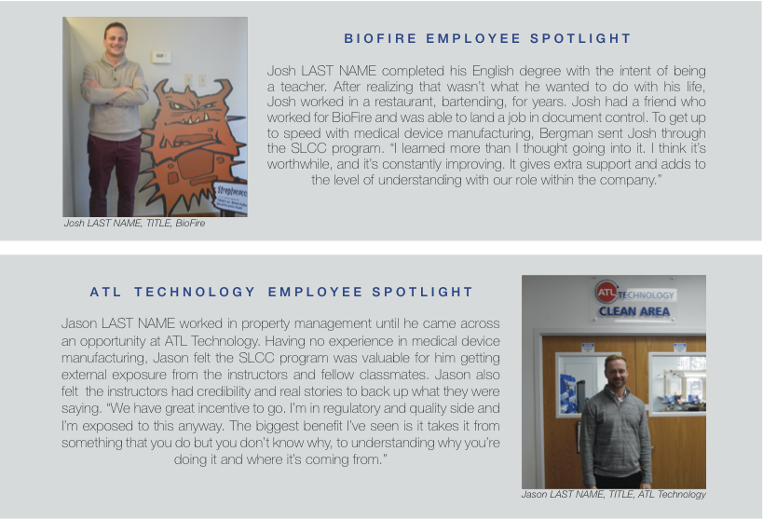

Slide 10
HIGHLIGHTS: SLCC
Every Quality Assurance employee at BioFire has the option to take the SLCC program, and it is strongly encouraged for lower level employees for promotion capabilities.
“I have promoted people that have attended and I do believe it has increased their confidence, skill set and their ability to feel like a real QA person.”
Investing in their future.
ATL Technology experiences 50% savings on training costs from SLCC
1% pay raise for every class his employees take
CEO took course himself and found instructors to be “outstanding.”

Slide 11
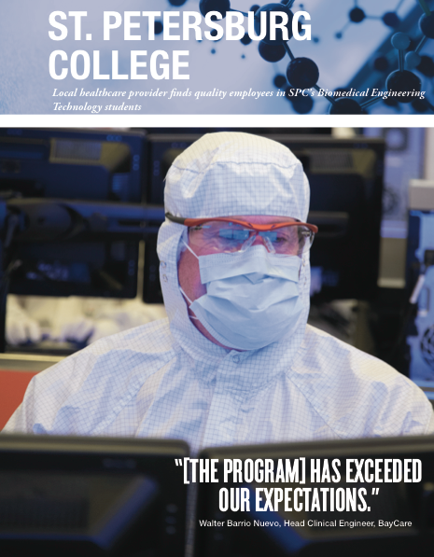
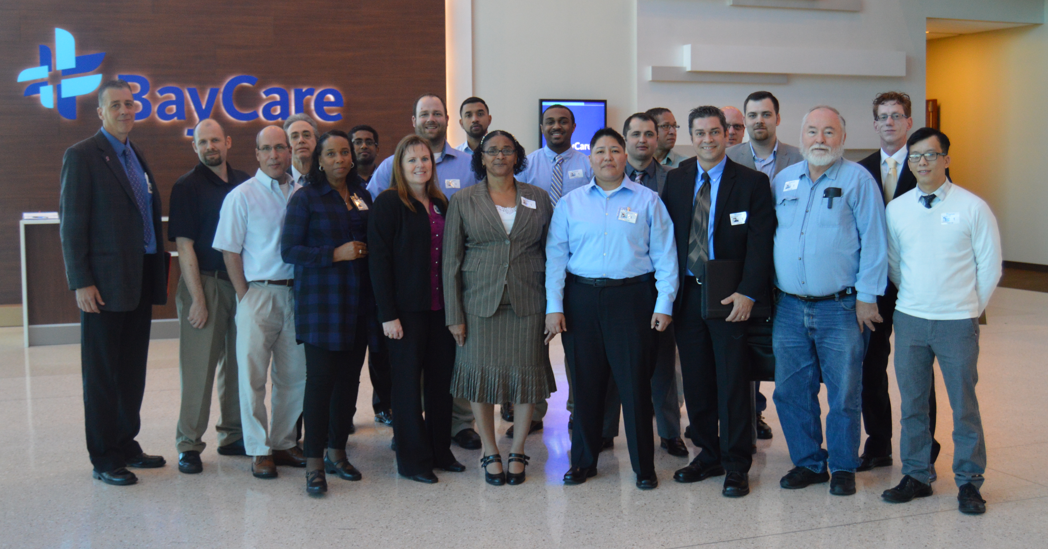

Slide 12
HIGHLIGHTS: ST. PETES
BayCare employee is instructor in program, allowing them to give input on designing the program to meet their own needs.
St. Pete students make up 10% of their biomedical department.
Bring in students once a quarter for training, networking, preparation, etc.
“The quality of candidates from St. Petes is much higher. This relationship helps us, and it helps them.”

Slide 13
Expanding Relationships
Baxalta – continue training certificate program
SLCC – using instructors to reach their companies
BioFire using training for QA department, but what about others?
Biomedical Society
Reaching out to suppliers
MEPs
Track numbers!
Notes:
Most important thing that has come out of these visits is seeing how you already are and how you can better utilize relationships you already have.
SLCC --- 4 instructors in Utah from companies that aren’t involved w/ program – Getting them involved
Biofire using training for QA department, but what about the other departments that could be using this training
St. Pete’s bringing in their local Biomedical Society professionals to enhance the training
Reaching out to suppliers
MEP

Slide 14
Dissemination Plan
Distributing print-ready files
Releasing on “Best Practices” webpage for both companies and educators
PR push using NAM contacts and Institute contacts
Notes:
Full PR push includes
Releasing press release on website and via meltwater
Reaching out to our close media list
NAM communications team
Front page graphic/twitter
Pushing out to SAGs and CMAs
________
Print-ready documents for you all to professionally print. Use to go to manufacturers and say here’s what we’ve been doing with these manufacturers, here’s what they are getting out of it, and here’s what you can get out of it as well.

Slide 15
Questions?

Slide 16
Contact Information
Cristina Crawford
Program Coordinator
The Manufacturing Institute
E-mail: ccrawford@nam.org
www.themanufacturinginstitute.org
@TheMfgInstitute

